Slide 1
Instagram User Analytics
By- Rahul M Ramchandani

Slide 2
About the Project
The goal of this project is to use my SQL skills to extract meaningful insights from the data which is Instagram user base. These insights will help the product manager and the rest of the team make informed decisions about the future direction of the Instagram app. The findings could potentially influence the future development of one of the world's most popular social media platform.
Software used:
MySQL Workbench 8.0 CE

Slide 3
SQL Tasks
A) Marketing Analysis: 1. Loyal User Reward 2. Inactive User Engagement 3. Contest Winner Declaration 4. Hashtag Reach 5. Ad Campaign Launch
B) Investor Metrics: 1. User Engagement 2. Bots & Fake Accounts

Slide 4
A) Marketing Analysis
1. Loyal User Reward- Task: Identify the five oldest users on Instagram from the provided database.
Query – SELECT id, username, created_at FROM users ORDER BY created_at ASC LIMIT 5;

Slide 5
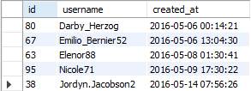
Identify the five oldest users on Instagram from the provided database.
Output -

Slide 6
A) Marketing Analysis:
2. Inactive User Engagement - Task: Identify users who have never posted a single photo on Instagram.
Query – SELECT u.username, u.id FROM users u left join photos p on u.id=p.user_id where p.id is null order by u.id

Slide 7
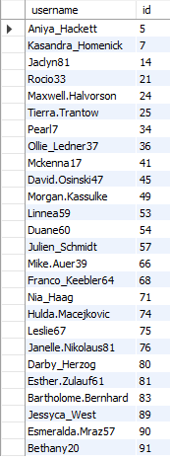
Identify users who have never posted a single photo on Instagram
Output –
26 records in total

Slide 8
A) Marketing Analysis
3. Contest Winner Declaration: The team has organized a contest where the user with the most likes on a single photo wins. Task: Determine the winner of the contest and provide their details to the team.
Query – SELECT u.id, u.username, p.id AS photo_id, COUNT(l.photo_id) AS total_likes, p.image_url FROM users u JOIN photos p ON u.id = p.user_id LEFT JOIN likes l ON p.id – l.photo_id GROUP BY u.id, u.username, p.id ORDER BY total_likes DESC LIMIT 1;

Slide 9

Determine the winner of the contest and provide their details to the team.
Output – Zack_Kemmer93 is the winner as he has the most number of likes on his single photo with photo_id - 145

Slide 10
A) Marketing Analysis
4. Hashtag Research: Task: Identify and suggest the top five most commonly used hashtags on the platform.
Query – SELECT t.tag_name, COUNT(pt.photo_id) AS tag_count FROM tags t JOIN photo_tags pt ON t.id = pt.tag_id GROUP BY t.tag_name ORDER BY tag_count DESC LIMIT 5;

Slide 11
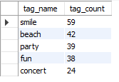
Identify and suggest the top five most commonly used hashtags on the platform.
Output –

Slide 12
A) Marketing Analysis
5. Ad Campaign Launch- The team wants to know the best day of the week to launch ads. Task: Determine the day of the week when most users register on Instagram. Provide insights on when to schedule an ad campaign.
Query – SELECT dayname(created_at) as dayofweek, count(*) as no_of_users_registered FROM users GROUP BY dayofweek ORDER BY no_of_users_registered desc;

Slide 13
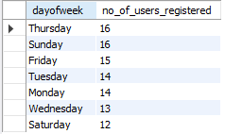
Determine the day of the week when most users register on Instagram. Provide insights on when to schedule an ad campaign.
Output –

Slide 14

B) Investor Metrics
1. User Engagement: Investors want to know if users are still active and posting on Instagram or if they are making fewer posts.
Task: Calculate the average number of posts per user on Instagram. Also, provide the total number of photos on Instagram divided by the total number of users.
Query - SELECT count(*)/count(distinct user_id) as Avg_num_of_post_per_user FROM photos;
Output – There are total 257 photos and total 74 distinct user in photo table which gives desired output 257/74 =3.47. Average number of posts per user is 3.

Slide 15
B) Investor Metrics
2. Bots & Fake Accounts: Investors want to know if the platform is crowded with fake and dummy accounts.
Task: Identify users (potential bots) who have liked every single photo on the site, as this is not typically possible for a normal user.
Query - SELECT l.user_id, u.username, COUNT(DISTINCT l.photo_id) AS total_no_of_photos_liked FROM likes l LEFT JOIN user u on l.user_id = u.id GROUP BY l.user_id having total_no_of_photos_liked = (SELECT COUNT(*) FROM photos) ;

Slide 16
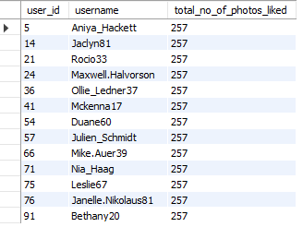
Identify users (potential bots) who have liked every single photo on the site, as this is not typically possible for a normal user.
Output – These users can be identified as bots or fake accounts

